Slide 1



Microsoft Stock Price Forecasting

Slide 2

Title Goes Here

Slide 3

Problem Statement
Objective
Introduction
Data Dictionary
Exploratory Analysis
Model Comparison
Best Model
Business Insights
Agenda

Slide 4

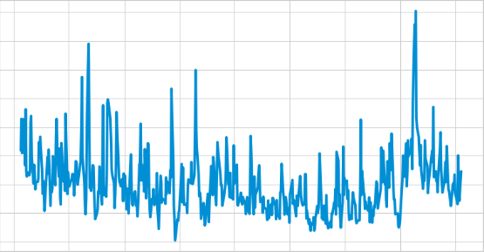
Problem Statement
Stock prices are highly volatile in nature and the price of a stock is determined by a variety of factors.
Nowadays, many people are involved in the stock market, either directly or indirectly.
As a result, identifying market trends has become absolutely essential to maximize returns on investments
For our analysis, we used historical data of Microsoft stock price available on Yahoo Finance.
Notes:
For a new investor, general research of the stock market is not really enough to make any investment decision. The common trend towards the stock market is highly risky for investment, so most of the people are not able to make decision based on common trends. They fail to understand the nuances of the data. The seasonal variance and steady flow of any stock will help both existing and new investors to understand and make a decision to invest in a particular stock. So our forecasting analysis will help the investors in deciding whether they should invest for long term or make a short term investments in Microsoft Stocks and will also help the company to make business decisions as per the price forecast.

Slide 5
Objective
The goal is to forecast Microsoft stock prices in order to make data - driven decisions and accurate investing decisions.
Notes:
The motive behind making multiple forecasting models is to find the best fitting model to predict the Microsoft Stock price using the historical data which will eventually help the investors to make an investment decision as well as the company to better plan their future

Slide 6

About Microsoft
Be What’s Next.
Microsoft is a multinational software company with its headquarter in Redmond, Washington.
Premier producer of personal-computer software systems and applications, and it supports a wide variety of computing-related products and services.
Founded by Bill Gates and Paul Allen on April 4, 1975
World’s largest software making company in terms of revenue

Slide 7
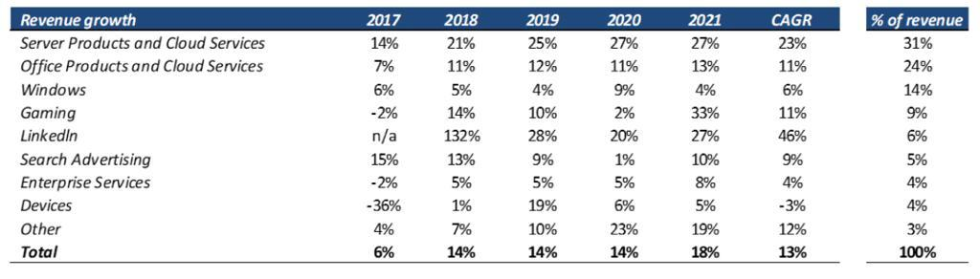
Microsoft: Revenue Growth
Notes:
Continuous growth in the revenue irrespective of market conditions makes Microsoft a highly dependable stock to bet on, however we just can’t take investment decision basis revenue growth only. So we have further analyzed the stock data to see how different models fit on the data.

Slide 8
Data Description
Data Source: Yahoo Finance
Date Range: April 13th 2020 to April 11th 2022
Target Variable: Adj Close
Other Variables:
Open: Opening `Stock Price of the day
High: Highest Stock Price of the day
Low: Lowest Stock Price of the day
Close: Closing Stock Price of the day
Volume: Total number of shares traded in a day

Slide 9
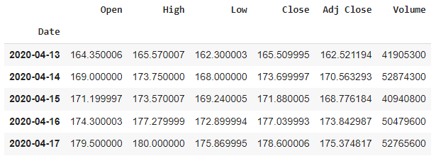
Data
Adj Close: Amends a stock’s closing price to reflect that stock’s value after accounting for any corporate actions, such as stock splits, dividends.
It is used when examining historical returns or detailed analysis of past performance.

Slide 10
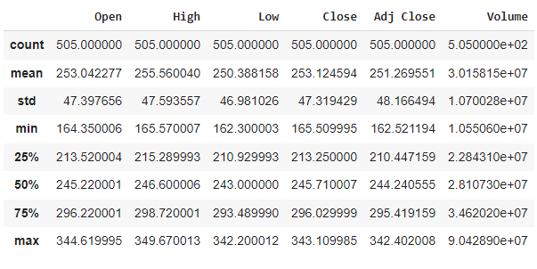
Data
Target variable: Adj Close
Total number of entries: 505
Maximum value of Adj Close: 342.402008
Minimum value of Adj Close: 162.521194
Mean value of Adj Close: 251.269551

Slide 11
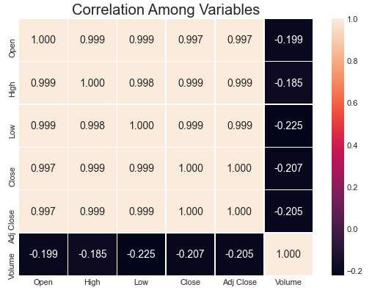
Data Exploration
Correlation
Maximum Positive Correlation: 1.000
Maximum Positive Correlation is between Adj Close and Close
Maximum Negative Correlation: -0.225
Maximum Negative Correlation is between Low and Volume

Slide 12
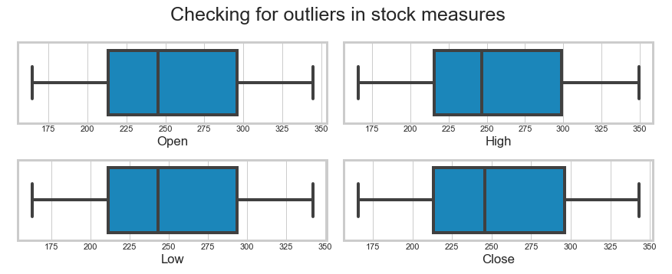
Data Exploration
Outliers
No outliers are observed in the data, as all the data points for the features are within the box plot

Slide 13
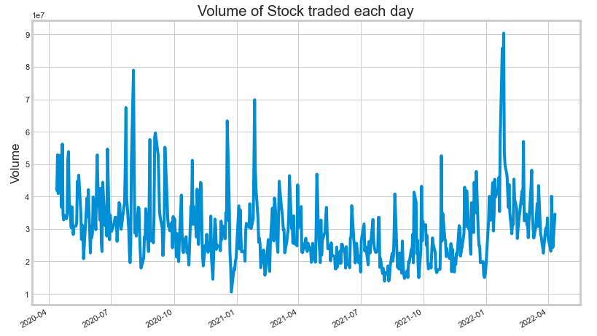
Data Exploration
Stock Volume
Maximum number of shares were traded between the months of January and February 2022
Minimum number of shares were traded between the months of December 2020 and January 2021

Slide 14
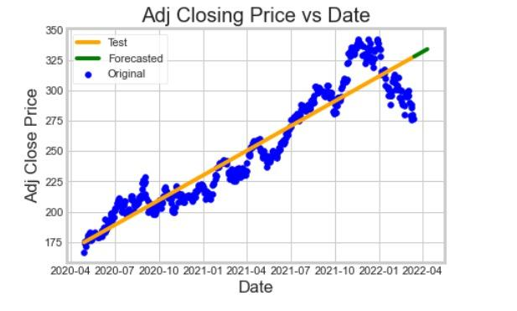
Model - Linear Regression
Initially the model showed a good fit as the actual price (blue dots) fit closely on the regression line (yellow)
Later on the actual price was away from the predicted price, increasing the error of the predictions

Slide 15
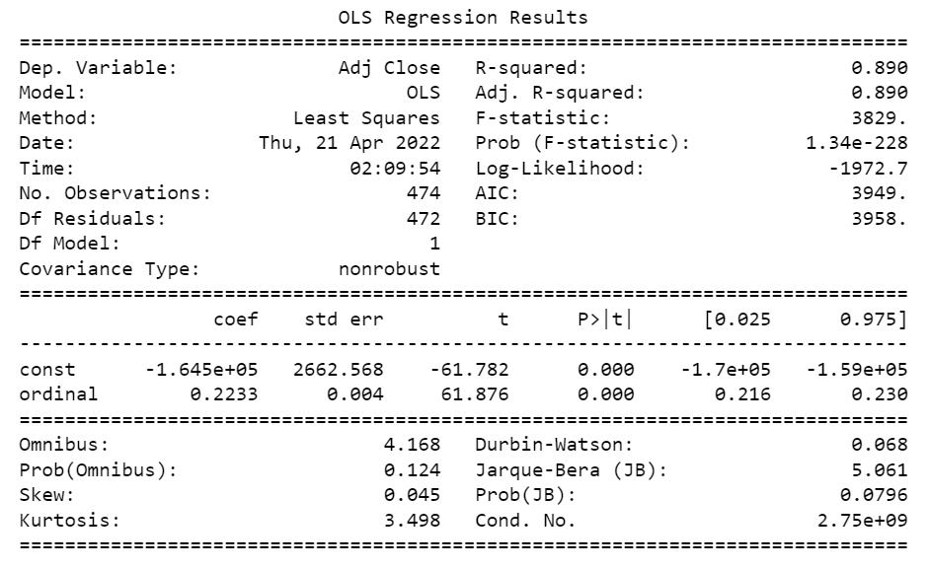
Model - Linear Regression
R-Squared - 0.890
Mean Squared Error - 256.26
RMSE - 16.04

Slide 16
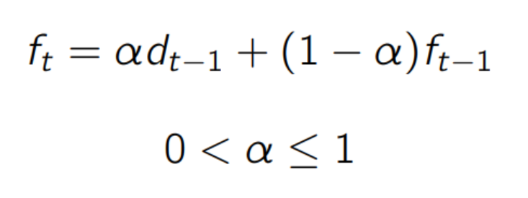
Model - Double Exponential Smoothing
Single Exponential Smoothing:
The idea of this model is to assume that the future will be more or less the same as the (recent) past.
The weight put on each observation decreases exponentially over time. Most recent observation having the highest weight.
alpha = importance the model will allocate to the most recent observation
alpha d(t-1) = represents previous observation times the learning rate
(1-alpha)f(t-1) = represents how much the model remembers from its previous forecast
Notes:
https://towardsdatascience.com/simple-exponential-smoothing-749fc5631bed

Slide 17
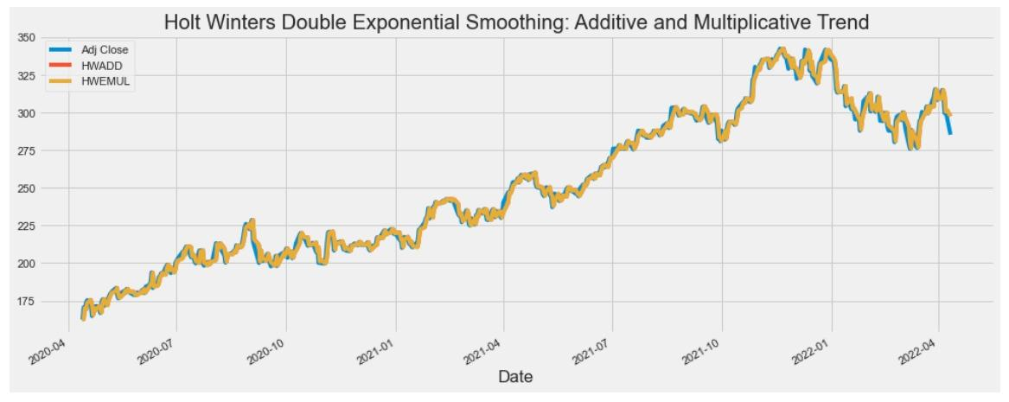
Model - Double Exponential Smoothing
Mean Squared Error - 17.09
RMSE - 4.13
Notes:
https://medium.com/analytics-vidhya/a-thorough-introduction-to-holt-winters-forecasting-c21810b8c0e6

Slide 18
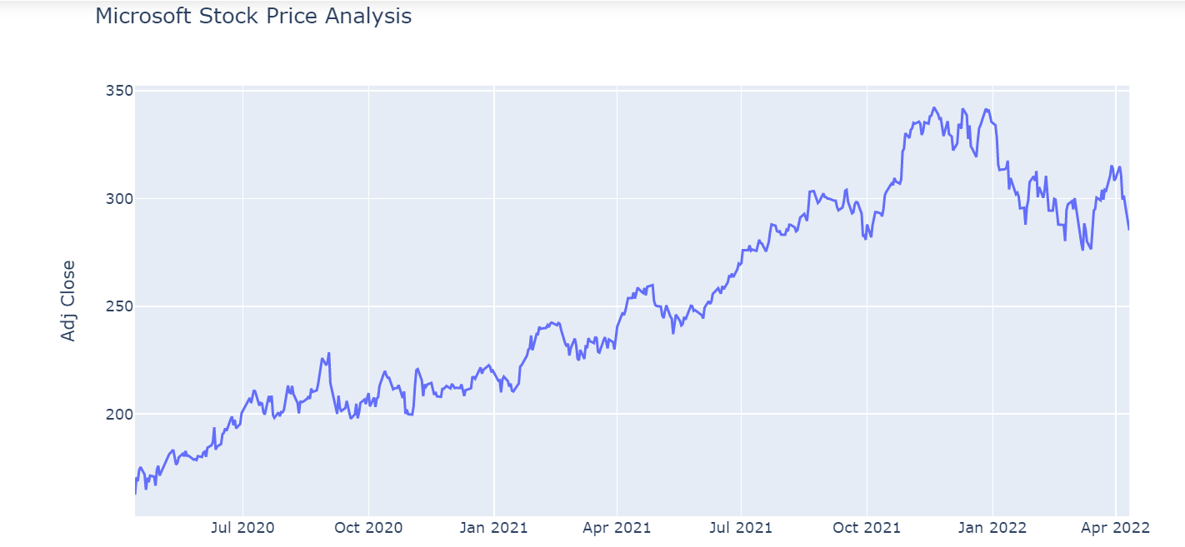
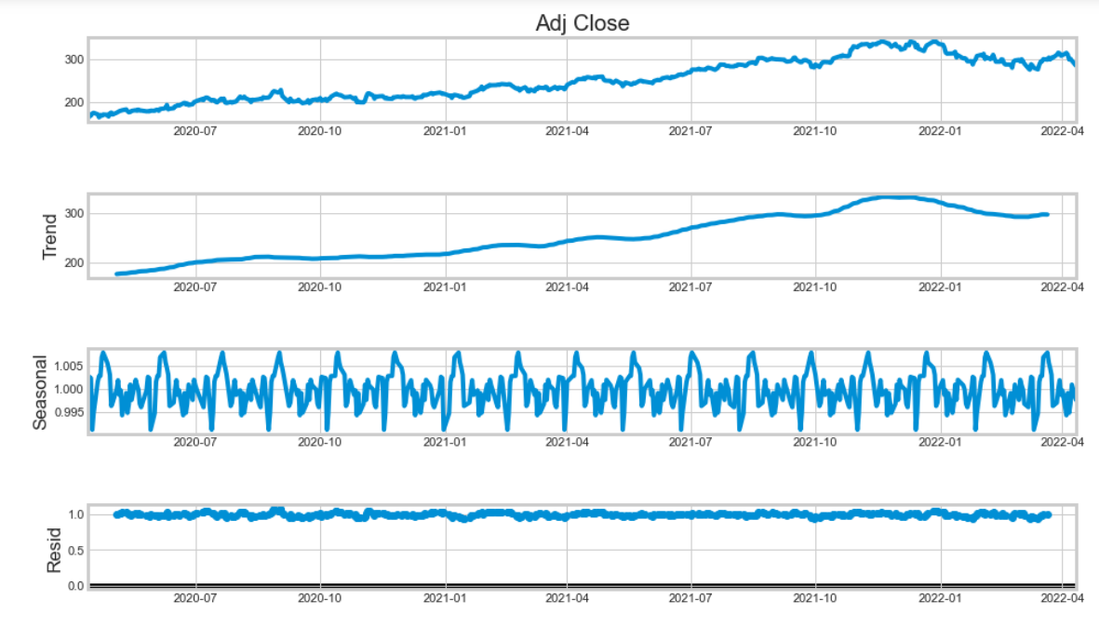
Model - ARIMA
Equation
y’(t) = c + ϕ1* y′(t−1) +⋯ + ϕp*y′(t−p) + θ1*ε(t−1) +⋯ + θq*ε(t−q) + εt

Slide 19
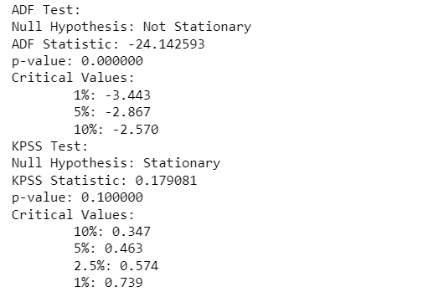
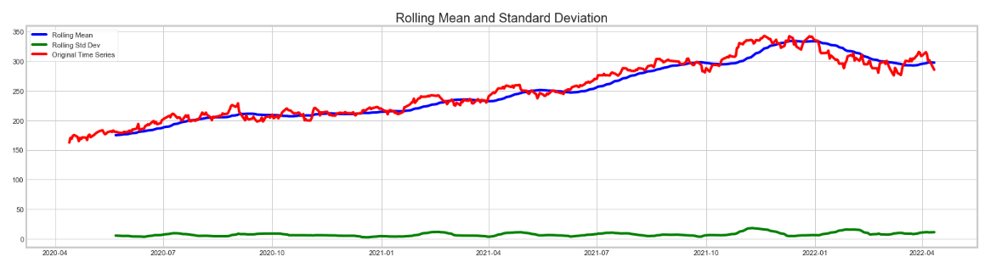
Model - ARIMA
ARIMA Model assumes that the time series is stationary
The original series is not stationary as it clearly as han upward trend
Also from the statistical test suggests that Series is not stationary

Slide 20

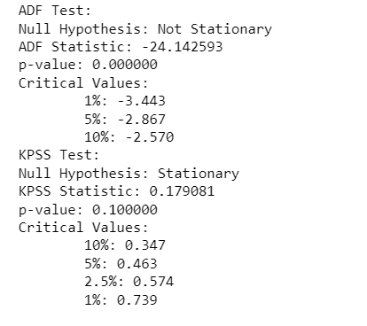
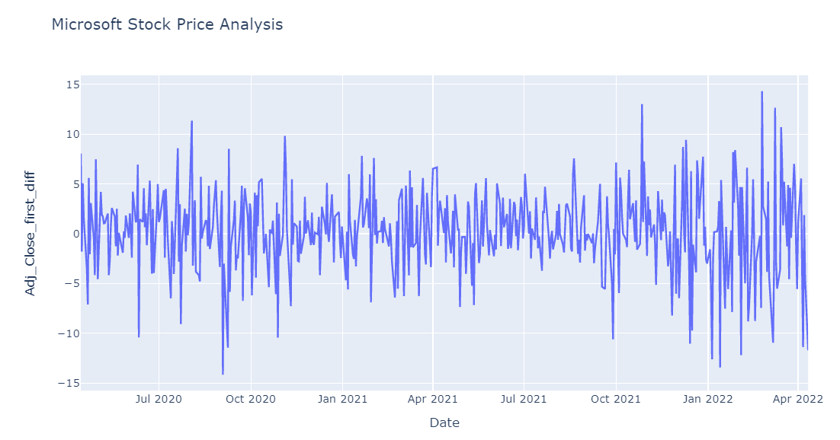
Model - ARIMA
Differencing the series to make it stationary
After first order differencing the seires becomes stationary
The series can now be used for ARIMA modeling

Slide 21
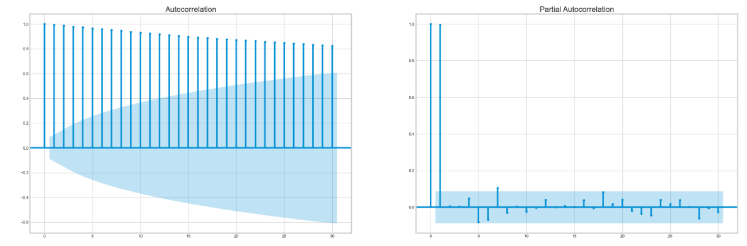
Model - ARIMA
ACF
PACF
THE ACF plot decays exponentially
IN PACF plot the is a sharp drop after 1 lag
p,q values are determined using the above plots

Slide 22
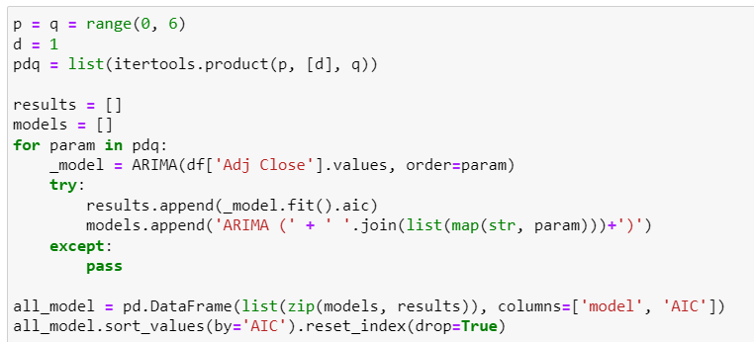
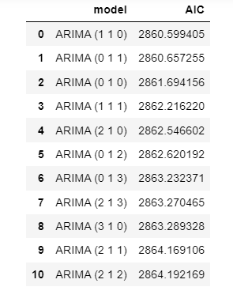
Model - ARIMA
Building ARIMA model for all possible nearby values of p,d,q determined from previous step

Slide 23
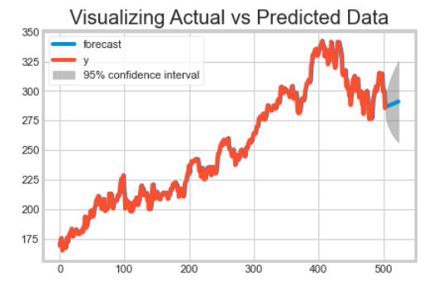
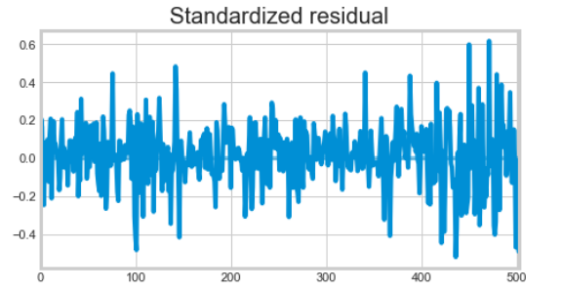
Model - ARIMA
The residuals obtained from ARIMA model are distributed around zero and not correlated
The RMSE obtained from the model is 88.2

Slide 24
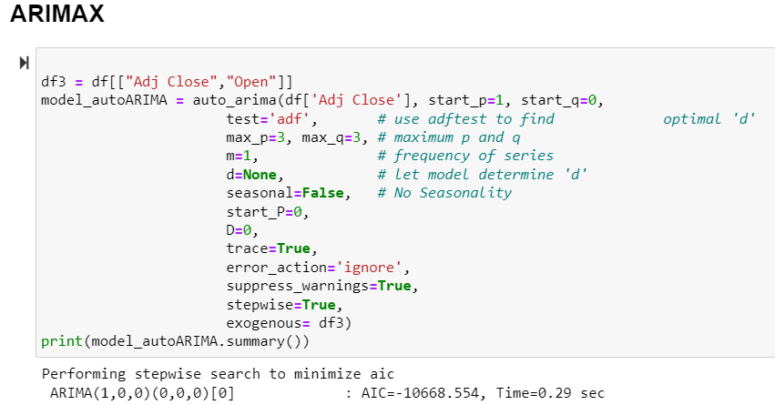
Model - ARIMAX
ARIMAX model combined ARIMA with external intervention
Here we considered open price as proxy for exogenous variable

Slide 25
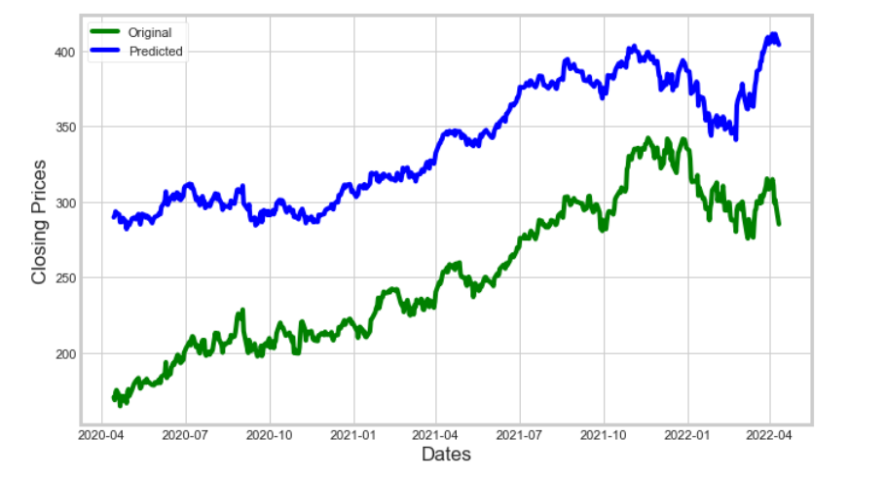
Model - ARIMAX
The Addition of new variables disrupt the fit of the model
New external variables should be identified and incorporated into the model

Slide 26
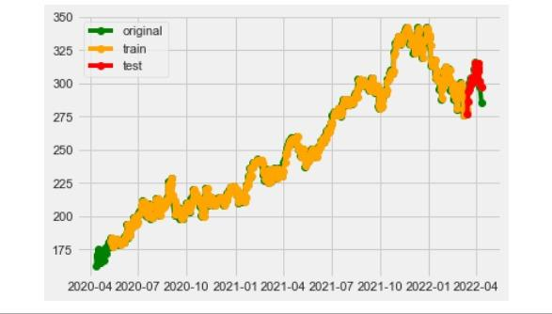
Business Insights
Best Model - Double Exponential Smoothing
Investors can identify the pattern (Rise & Fall) to identify MSFT stocks for better planning.
External Factors -
Sentiment Analysis
Antitrust Issues
External Investments
Acquisition of Activision Blizzard
Unprecedented Crisis
Covid19
Business and Tech News
Inflation Rate
War Crisis
Notes:
Time series forecasting is a very intriguing field to work with, as I have realized during my time writing these articles. There is a perception in the community that it’s a complex field, and while there is a grain of truth in there, it’s not so difficult once you get the hang of the basic techniques.
I am interested in finding out how LSTM works on a different kind of time series problem and encourage you to try it out on your own as well. If you have any questions, feel free to connect with me in the comments section below.

Slide 27
References
MSFT Stock Analysis https://www.britannica.com/topic/Microsoft-Corporation
MSFT Stock Price Data https://finance.yahoo.com/quote/MSFT/history?p=MSFT
Is A Microsoft Stock Split Likely In 2022? http://seekingalpha.com/amp/arti
How Microsoft’s $68.7 billion deal for Activision Blizzard came together https://www.theverge.com/22941636/microsoft-activision-blizzard-acquisition-sec-filing-came-together
Here's Why Microsoft Stock Was Up 11% in Juneeres-why-microsoft-stock-was-up-11-in-june.aspx
https://medium.com/analytics-vidhya/a-thorough-introduction-to-holt-winters-forecasting-c21810b8c0e6

Slide 28

THANK YOU

Slide 29
Q&A

